Slide 1
Assignment 3

Slide 2
Mostafa Hassnien Ahmed (1180581)
Hussin Ahmed Ibrahim (1180594)

Slide 3
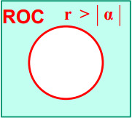


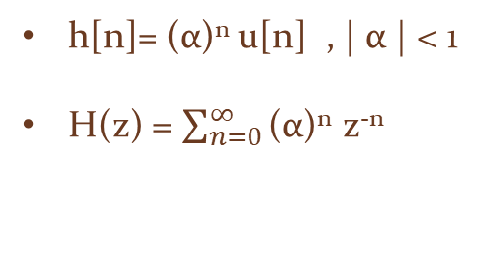





h[n]= (α)^{n} u[n] , | α | < 1
H(z) = $\sum_{n=0}^{∞}{\text{(}\text{α}\text{)}\text{n} }\text{z}\text{−}\text{n}$
H(z) = $\sum_{n=0}^{∞}{\text{(}\text{α} \text{z} \text{−} \text{1}\text{)}\text{n} }$
, this is a sum of an infinite geometric series
a “First Term” = 1
r “Base” = $\text{α} \text{z} \text{− }\text{1}$
N = $∞$
Note
| r | < 1
This infinite geometric series is finite only if
Thus, to find the region of convergence (ROC):
| r | < 1
| $\text{α} \text{z} \text{− }\text{1}$| < 1
| $\frac{\text{α}}{r}$| < 1
| α | < r
H(z) = $\frac{\text{First} \text{Term}}{1 − Base}$
H(z) = $\frac{\text{1}}{1 − \text{α} \text{z}\text{−}\text{1} }$ , ROC | α | < r

Slide 4


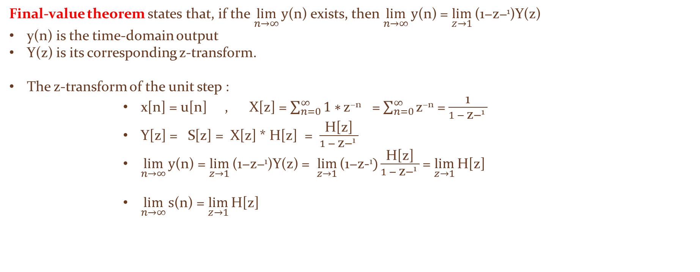
Since | α | < 1 , h[n] is decreasing exponential and Fourier Transform (FT) exists “ Unit Circle is within the ROC ”
H($\text{e} \text{j}Ω$) = H(z) |_{r = 1}
= $\frac{\text{1}}{1 − \text{α}\text{e}\text{−} \text{j}Ω}$
Final-value theorem states that, if the $\lim_{n→∞}{\text{y}\text{(}\text{n}\text{)}}$exists, then $\lim_{n→∞}{\text{y}\text{(}\text{n}\text{)}}$ = $\lim_{z→1}{\text{(}\text{1}\text{−}\text{z}\text{−}\text{1}\text{)}\text{Y}\text{(}\text{z}\text{)}}$
y(n) is the time-domain output
Y(z) is its corresponding z-transform.
The z-transform of the unit step :
x[n] = u[n] , X[z] = $\sum_{n=0}^{∞}{1∗}\text{z}\text{−}\text{n}$ = $\sum_{n=0}^{∞}{\text{z}\text{−}\text{n}}$ = $\frac{\text{1}}{1 − \text{z}\text{−}\text{1} }$
Y[z] = S[z] = X[z] * H[z] = $\frac{\text{H}\text{[}\text{z}\text{]}}{1 − \text{z}\text{−}\text{1 }}$
$\lim_{n→∞}{\text{y}\text{(}\text{n}\text{)}}$ = $\lim_{z→1}{\text{(}\text{1}\text{−}\text{z}\text{−}\text{1}\text{)}\text{Y}\text{(}\text{z}\text{)}}$ = $\lim_{z→1}{\text{(}\text{1}\text{−}\text{z}\text{−}\text{1})\frac{\text{H}\text{[}\text{z}\text{]}}{1 − \text{z}\text{−}\text{1 }}}$ = $\lim_{z→1}{\text{H}\text{[}\text{z}\text{]}}$
$\lim_{n→∞}{\text{s}\text{(}\text{n}\text{)}}$ = $\lim_{z→1}{\text{H}\text{[}\text{z}\text{]}}$

Slide 5
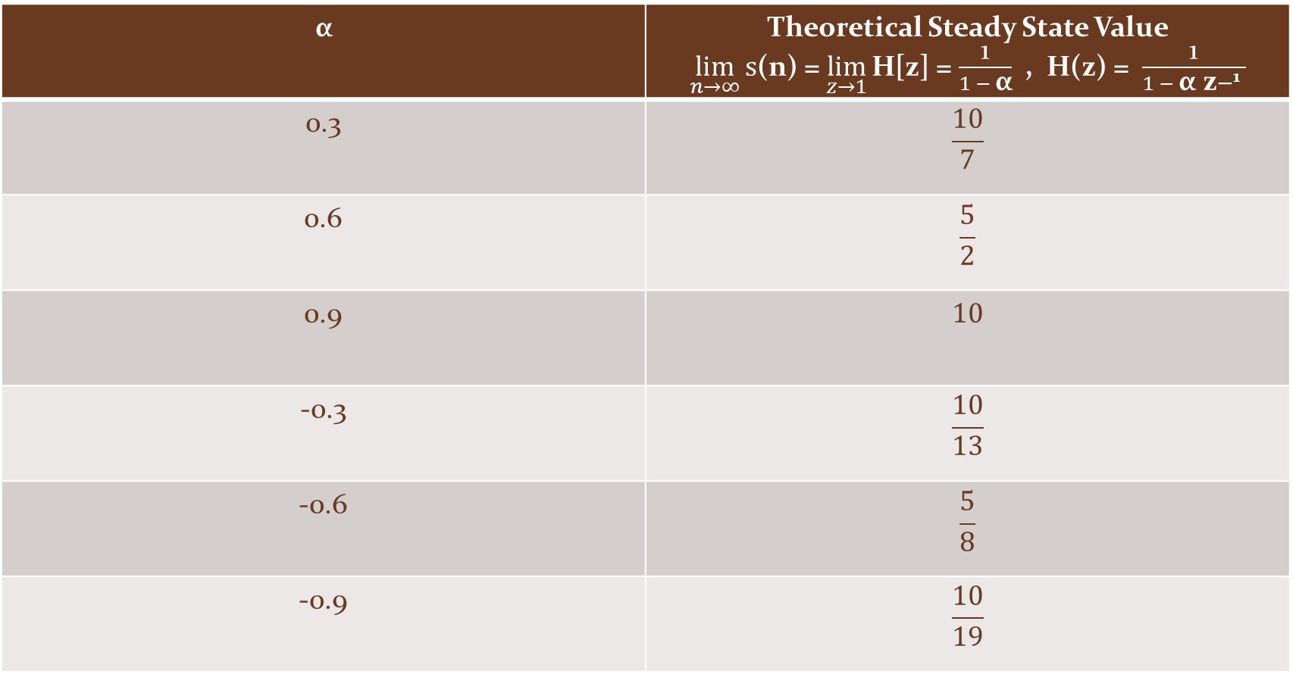
$$\text{α}$$ | Theoretical Steady State Value $\lim_{n→∞}{\text{s}\text{(}\text{n}\text{)}}$ = $\lim_{z→1}{\text{H}\text{[}\text{z}\text{]}}$= $\frac{\text{1}}{1 − \text{α}}$ , H(z) = $\frac{\text{1}}{1 − \text{α} \text{z}\text{−}\text{1} }$
0.3 | $$\frac{10}{7}$$
0.6 | $$\frac{5}{2}$$
0.9 | $$10$$
-0.3 | $$\frac{10}{13}$$
-0.6 | $$\frac{5}{8}$$
-0.9 | $$\frac{10}{19}$$

Slide 6


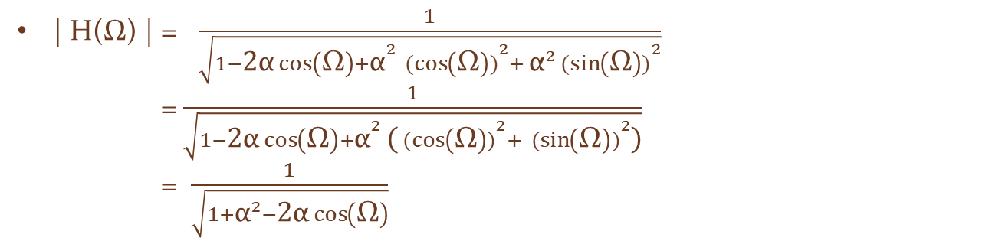
H(Ω) = $\frac{\text{1}}{1 − \text{α}\text{e}\text{− }\text{j}Ω}$
| H(Ω) | = | $\frac{\text{1}}{1 − \text{α}\text{e}\text{− }\text{j}Ω}$ |
| H(Ω) | = | $\frac{\text{1}}{\left(1−\text{α}\cos\left(\text{Ω}\right)\right)+j\text{α}\sin\left(\text{Ω}\right)}$ | = $\frac{1}{\sqrt{{(1−\text{α}\cos\left(\text{Ω}\right))}^{2}+ {\text{(}\text{α}\sin\left(\text{Ω}\right))}^{2}}}$
| H(Ω) | = $\frac{1}{\sqrt{{1−\text{2}\text{α}\cos\left(\text{Ω}\right)+\text{α}}^{2} {(cos\left(\text{Ω}\right))}^{2}+ {{\text{α}}^{2}(sin\left(\text{Ω}\right))}^{2}}}$
= $\frac{1}{\sqrt{{1−\text{2}\text{α}\cos\left(\text{Ω}\right)+\text{α}}^{2} {\text{(}(cos\left(\text{Ω}\right))}^{2}+ { (sin\left(\text{Ω}\right))}^{2}\text{)}}}$
= $\frac{1}{\sqrt{1{+\text{α}}^{2}−\text{2}\text{α}\cos\left(\text{Ω}\right)}}$
| H(0) | = $\frac{1}{\sqrt{1{+\text{α}}^{2}−\text{2}\text{α}\cos\left(\text{0}\right) }} =\frac{1}{\sqrt{1{+\text{α}}^{2}−\text{2}\text{α}}}$ = $\frac{1}{\sqrt{{\text{(}\text{1}\text{−}\text{α}\text{)}}^{2}}} =\frac{1}{\text{1}\text{−}\text{α}}$
| H($π$) | = $\frac{1}{\sqrt{1{+\text{α}}^{2}−\text{2}\text{α}\cos\left(π\right) }} =\frac{1}{\sqrt{1{+\text{α}}^{2}+\text{2}\text{α}}}$ = $\frac{1}{\sqrt{{\text{(}\text{1}\text{+}\text{α}\text{)}}^{2}}} =\frac{1}{\text{1}\text{+}\text{α}}$

Slide 7
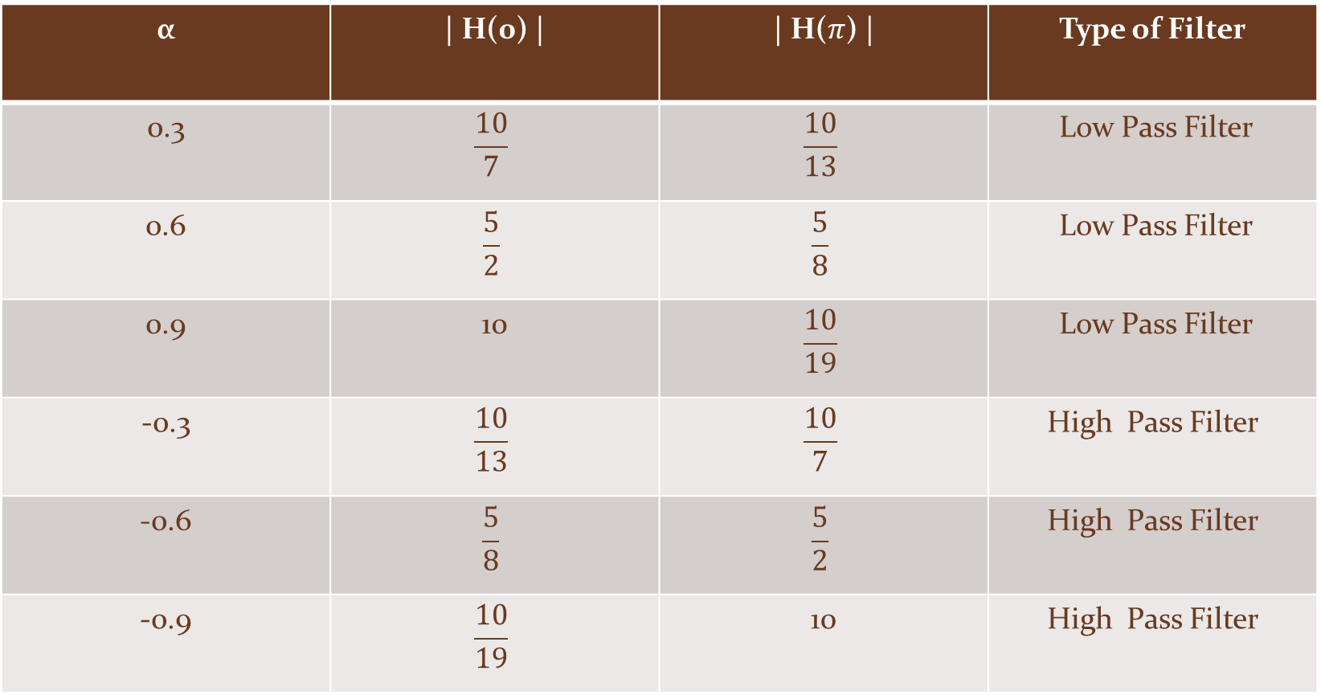
$$\text{α}$$ | | H(0) | | | H($π$) | | Type of Filter
0.3 | $$\frac{10}{7}$$ | $$\frac{10}{13}$$ | Low Pass Filter
0.6 | $$\frac{5}{2}$$ | $$\frac{5}{8}$$ | Low Pass Filter
0.9 | 10 | $$\frac{10}{19}$$ | Low Pass Filter
-0.3 | $$\frac{10}{13}$$ | $$\frac{10}{7}$$ | High Pass Filter
-0.6 | $$\frac{5}{8}$$ | $$\frac{5}{2}$$ | High Pass Filter
-0.9 | $$\frac{10}{19}$$ | 10 | High Pass Filter

Slide 8
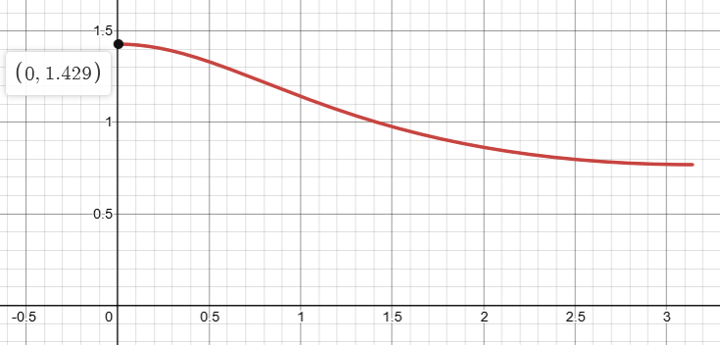
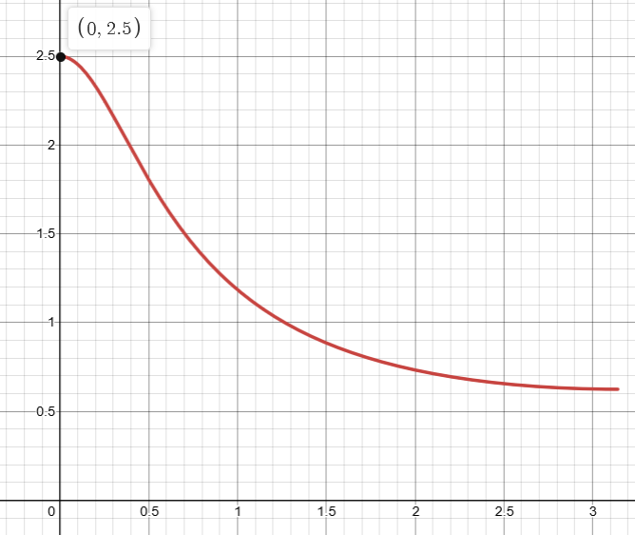
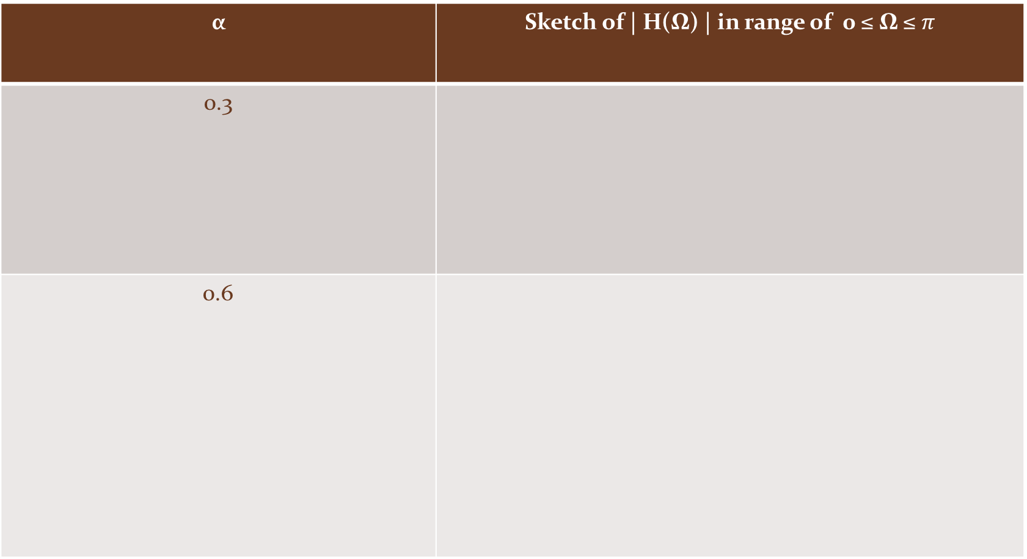
$$\text{α}$$ | Sketch of | H(Ω) | in range of 0 ≤ Ω ≤ $π$
0.3
0.6

Slide 9
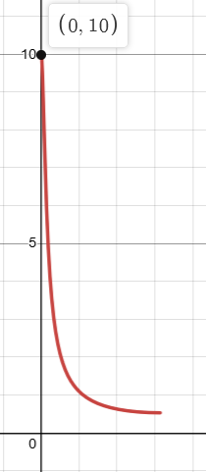
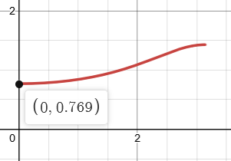
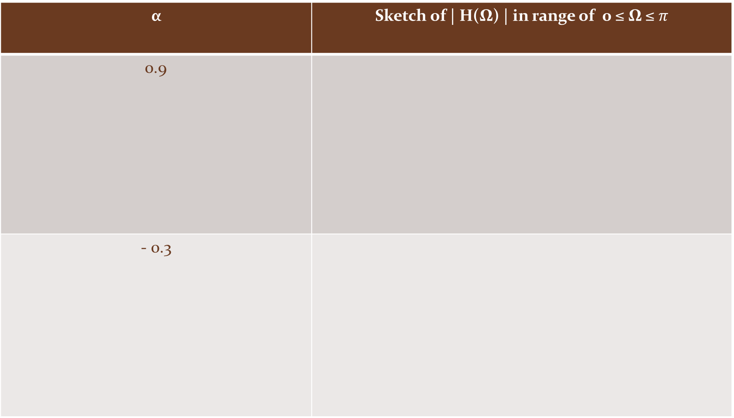
$$\text{α}$$ | Sketch of | H(Ω) | in range of 0 ≤ Ω ≤ $π$
0.9
- 0.3

Slide 10
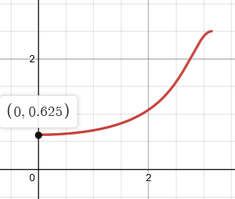
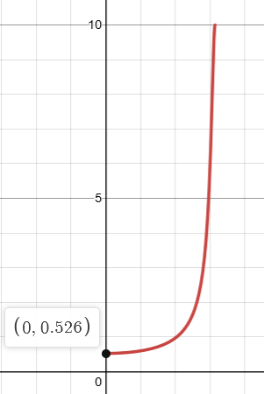
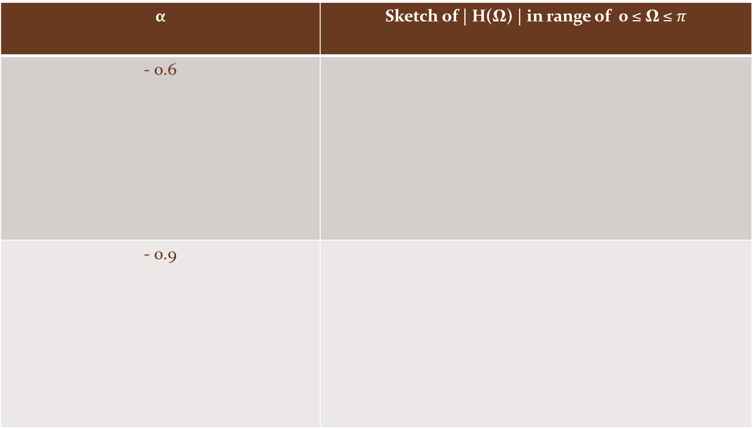
$$\text{α}$$ | Sketch of | H(Ω) | in range of 0 ≤ Ω ≤ $π$
- 0.6
- 0.9

Slide 11
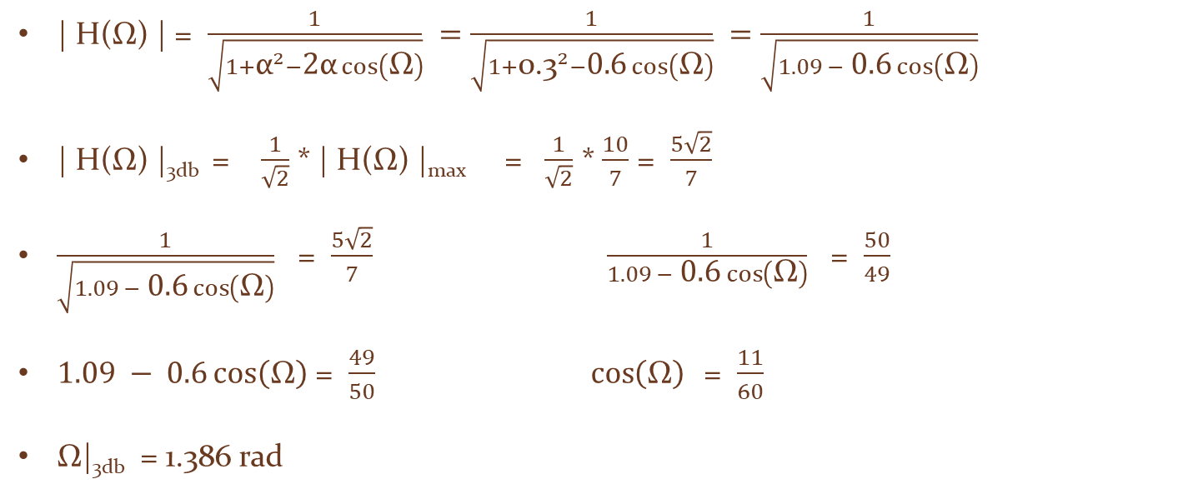

The 3-dB cut-off frequency Calculations
$\text{α}$ = 0.3
| H(Ω) | = $\frac{1}{\sqrt{1{+\text{α}}^{2}−\text{2}\text{α}\cos\left(\text{Ω}\right)}} =\frac{1}{\sqrt{1{+\text{0.}\text{3}}^{2}−\text{0.6}\cos\left(\text{Ω}\right)}} =\frac{1}{\sqrt{1.09 −\text{ 0.6}\cos\left(\text{Ω}\right)}}$
| H(Ω) |_{3db} = $\frac{1}{\sqrt{2}}$ * | H(Ω) |_{max} = $\frac{1}{\sqrt{2}}$ * $\frac{10}{7}$ = $\frac{5\sqrt{2}}{7}$
$\frac{1}{\sqrt{1.09 −\text{ 0.6}\cos\left(\text{Ω}\right)}}$ = $\frac{5\sqrt{2}}{7}$ $\frac{1}{1.09 −\text{ 0.6}\cos\left(\text{Ω}\right)}$ = $\frac{50}{49}$
$1.09 −\text{ 0.6}\cos\left(\text{Ω}\right)$ = $\frac{49}{50}$ $\cos\left(\text{Ω}\right)$ = $\frac{11}{60}$
Ω|_{3db} = 1.386 rad

Slide 12
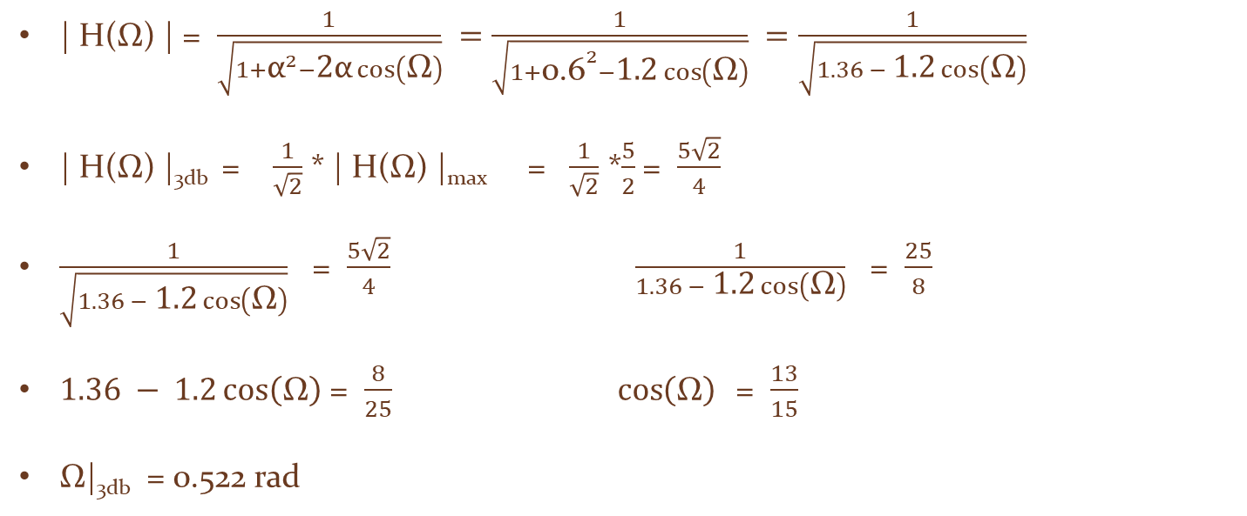

The 3-dB cut-off frequency Calculations
$\text{α}$ = 0.6
| H(Ω) | = $\frac{1}{\sqrt{1{+\text{α}}^{2}−\text{2}\text{α}\cos\left(\text{Ω}\right)}} =\frac{1}{\sqrt{1{+\text{0.}\text{6}}^{2}−\text{1.2}\cos\left(\text{Ω}\right)}} =\frac{1}{\sqrt{1.36 −\text{ 1.2}\cos\left(\text{Ω}\right)}}$
| H(Ω) |_{3db} = $\frac{1}{\sqrt{2}}$ * | H(Ω) |_{max} = $\frac{1}{\sqrt{2}}$ *$\frac{5}{2}$= $\frac{5\sqrt{2}}{4}$
$\frac{1}{\sqrt{1.36 − \text{1.2}\cos\left(\text{Ω}\right)}}$ = $\frac{5\sqrt{2}}{4}$ $\frac{1}{1.36 − \text{1.2}\cos\left(\text{Ω}\right)}$ = $\frac{25}{8}$
$1.36 − \text{1.2}\cos\left(\text{Ω}\right)$ = $\frac{8}{25}$ $\cos\left(\text{Ω}\right)$ = $\frac{13}{15}$
Ω|_{3db} = 0.522 rad

Slide 13
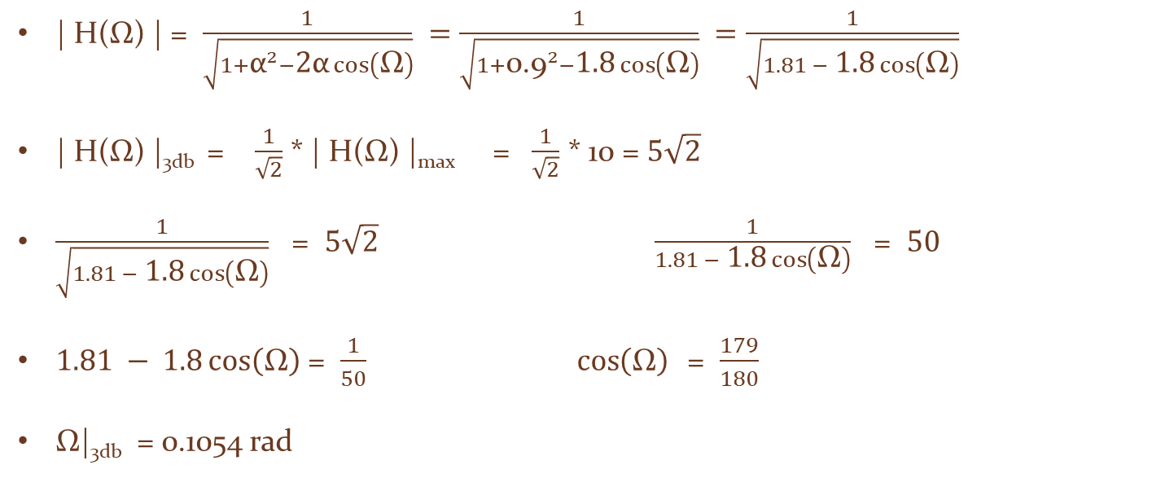

The 3-dB cut-off frequency Calculations
$\text{α}$ = 0.9
| H(Ω) | = $\frac{1}{\sqrt{1{+\text{α}}^{2}−\text{2}\text{α}\cos\left(\text{Ω}\right)}} =\frac{1}{\sqrt{1{+\text{0.}\text{9}}^{2}−\text{1.8}\cos\left(\text{Ω}\right)}} =\frac{1}{\sqrt{1.81 −\text{ 1.8}\cos\left(\text{Ω}\right)}}$
| H(Ω) |_{3db} = $\frac{1}{\sqrt{2}}$ * | H(Ω) |_{max} = $\frac{1}{\sqrt{2}}$ * 10 = $5\sqrt{2}$
$\frac{1}{\sqrt{1.81 − \text{1.8}\cos\left(\text{Ω}\right)}}$ = $5\sqrt{2} \frac{1}{1.81 − \text{1.8}\cos\left(\text{Ω}\right)}$ = $50$
$1.81 − \text{1.8}\cos\left(\text{Ω}\right)$ = $\frac{1}{50}$ $\cos\left(\text{Ω}\right)$ = $\frac{179}{180}$
Ω|_{3db} = 0.1054 rad

Slide 14
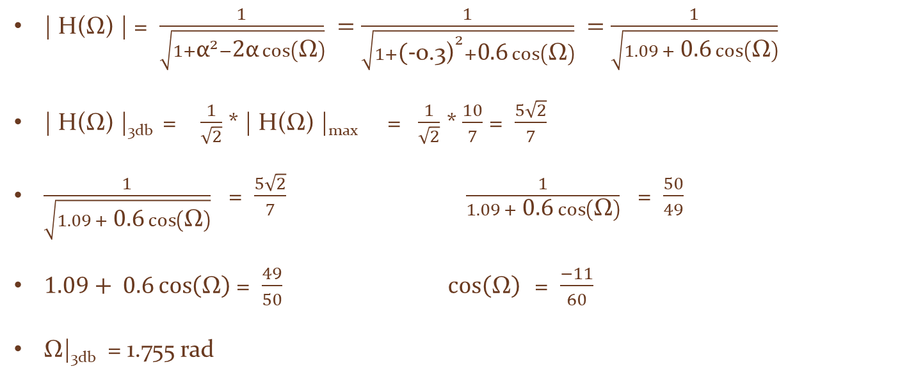

The 3-dB cut-off frequency Calculations
$\text{α}$ = - 0.3
| H(Ω) | = $\frac{1}{\sqrt{1{+\text{α}}^{2}−\text{2}\text{α}\cos\left(\text{Ω}\right)}} =\frac{1}{\sqrt{1{+\text{(}\text{−}\text{0.3}\text{)}}^{2}+\text{0.6}\cos\left(\text{Ω}\right)}} =\frac{1}{\sqrt{1.09 +\text{ 0.6}\cos\left(\text{Ω}\right)}}$
| H(Ω) |_{3db} = $\frac{1}{\sqrt{2}}$ * | H(Ω) |_{max} = $\frac{1}{\sqrt{2}}$ * $\frac{10}{7}$ = $\frac{5\sqrt{2}}{7}$
$\frac{1}{\sqrt{1.09 +\text{ 0.6}\cos\left(\text{Ω}\right)}}$ = $\frac{5\sqrt{2}}{7}$ $\frac{1}{1.09 +\text{ 0.6}\cos\left(\text{Ω}\right)}$ = $\frac{50}{49}$
$1.09+\text{ 0.6}\cos\left(\text{Ω}\right)$ = $\frac{49}{50}$ $\cos\left(\text{Ω}\right)$ = $\frac{−11}{60}$
Ω|_{3db} = 1.755 rad

Slide 15
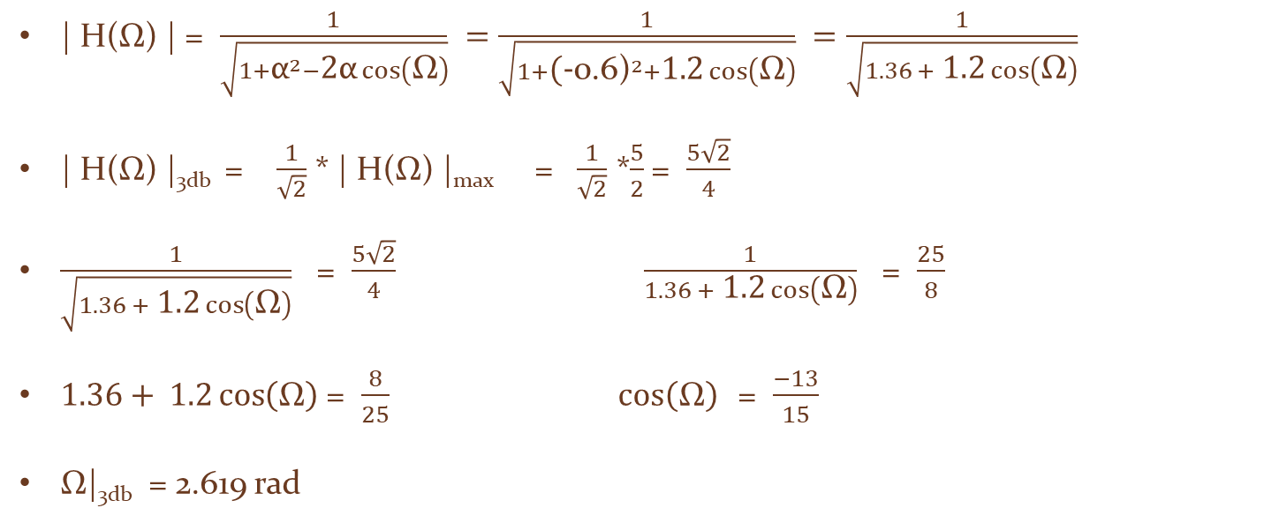

The 3-dB cut-off frequency Calculations
$\text{α}$ = - 0.6
| H(Ω) | = $\frac{1}{\sqrt{1{+\text{α}}^{2}−\text{2}\text{α}\cos\left(\text{Ω}\right)}} =\frac{1}{\sqrt{1{+\text{(}\text{−}\text{0.6}\text{)}}^{2}+\text{1.2}\cos\left(\text{Ω}\right)}} =\frac{1}{\sqrt{1.36 +\text{ 1.2}\cos\left(\text{Ω}\right)}}$
| H(Ω) |_{3db} = $\frac{1}{\sqrt{2}}$ * | H(Ω) |_{max} = $\frac{1}{\sqrt{2}}$ *$\frac{5}{2}$= $\frac{5\sqrt{2}}{4}$
$\frac{1}{\sqrt{1.36 + \text{1.2}\cos\left(\text{Ω}\right)}}$ = $\frac{5\sqrt{2}}{4}$ $\frac{1}{1.36 + \text{1.2}\cos\left(\text{Ω}\right)}$ = $\frac{25}{8}$
$1.36+ \text{1.2}\cos\left(\text{Ω}\right)$ = $\frac{8}{25}$ $\cos\left(\text{Ω}\right)$ = $\frac{−13}{15}$
Ω|_{3db} = 2.619 rad

Slide 16
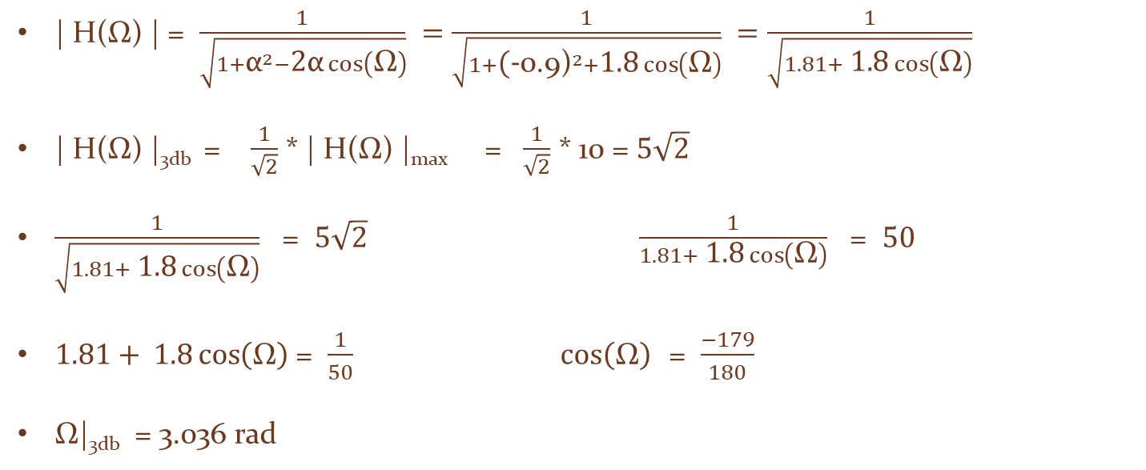

The 3-dB cut-off frequency Calculations
$\text{α}$ = - 0.9
| H(Ω) | = $\frac{1}{\sqrt{1{+\text{α}}^{2}−\text{2}\text{α}\cos\left(\text{Ω}\right)}} =\frac{1}{\sqrt{1{+\text{(}\text{−}\text{0.9}\text{)}}^{2}+\text{1.8}\cos\left(\text{Ω}\right)}} =\frac{1}{\sqrt{1.81+\text{ 1.8}\cos\left(\text{Ω}\right)}}$
| H(Ω) |_{3db} = $\frac{1}{\sqrt{2}}$ * | H(Ω) |_{max} = $\frac{1}{\sqrt{2}}$ * 10 = $5\sqrt{2}$
$\frac{1}{\sqrt{1.81+ \text{1.8}\cos\left(\text{Ω}\right)}}$ = $5\sqrt{2} \frac{1}{1.81+ \text{1.8}\cos\left(\text{Ω}\right)}$ = $50$
$1.81+ \text{1.8}\cos\left(\text{Ω}\right)$ = $\frac{1}{50}$ $\cos\left(\text{Ω}\right)$ = $\frac{−179}{180}$
Ω|_{3db} = 3.036 rad

Slide 17
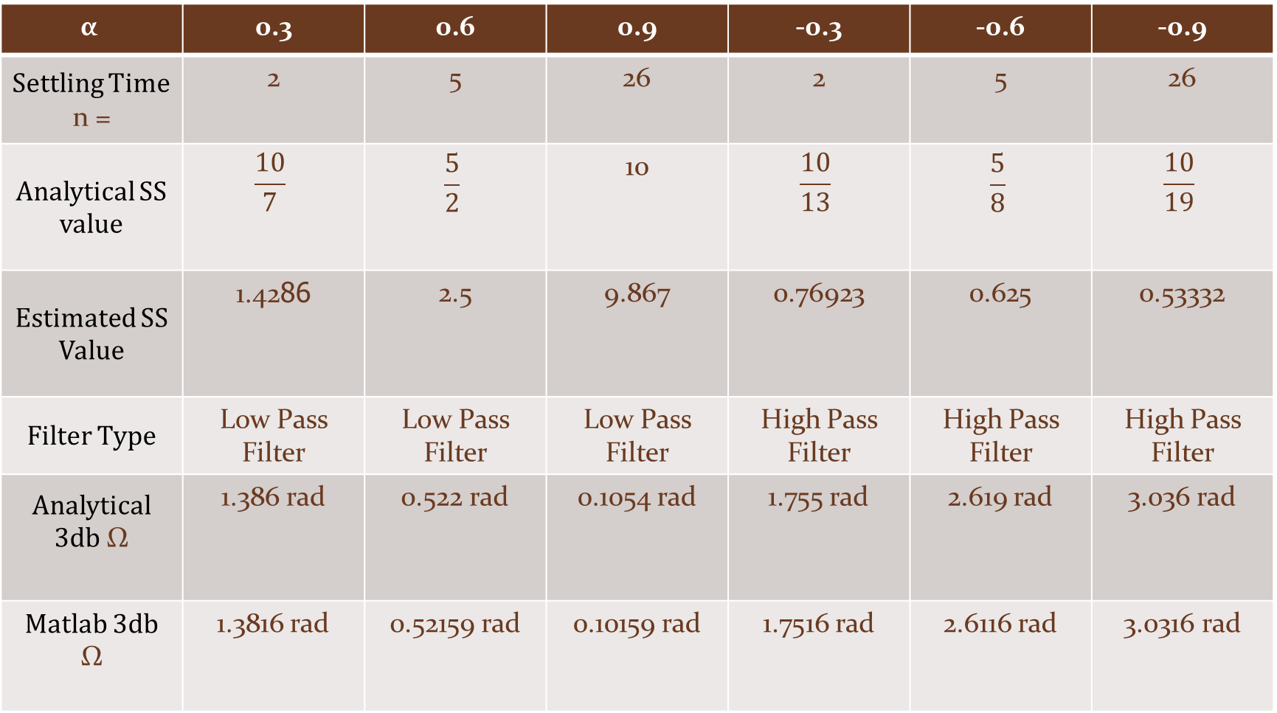
$$\text{α}$$ | 0.3 | 0.6 | 0.9 | -0.3 | -0.6 | -0.9
Settling Time n = | 2 | 5 | 26 | 2 | 5 | 26
Analytical SS value | $$\frac{10}{7}$$ | $$\frac{5}{2}$$ | 10 | $$\frac{10}{13}$$ | $$\frac{5}{8}$$ | $$\frac{10}{19}$$
Estimated SS Value | 1.4286 | 2.5 | 9.867 | 0.76923 | 0.625 | 0.53332
Filter Type | Low Pass Filter | Low Pass Filter | Low Pass Filter | High Pass Filter | High Pass Filter | High Pass Filter
Analytical 3db Ω | 1.386 rad | 0.522 rad | 0.1054 rad | 1.755 rad | 2.619 rad | 3.036 rad
Matlab 3db Ω | 1.3816 rad | 0.52159 rad | 0.10159 rad | 1.7516 rad | 2.6116 rad | 3.0316 rad

Slide 18
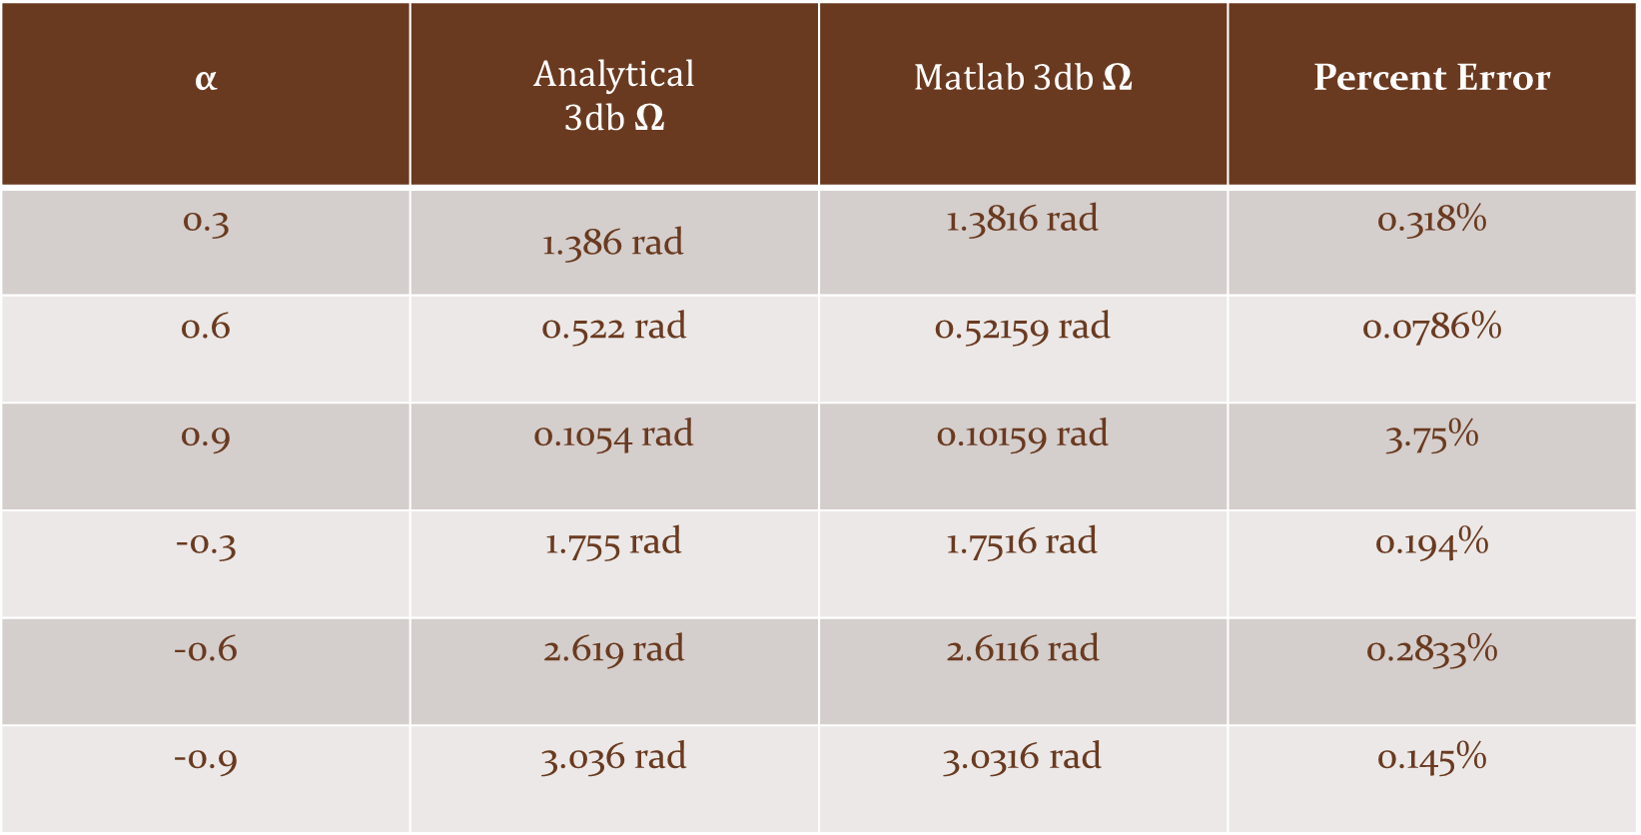
$$\text{α}$$ | Analytical 3db Ω | Matlab 3db Ω | Percent Error
0.3 | 1.386 rad | 1.3816 rad | 0.318%
0.6 | 0.522 rad | 0.52159 rad | 0.0786%
0.9 | 0.1054 rad | 0.10159 rad | 3.75%
-0.3 | 1.755 rad | 1.7516 rad | 0.194%
-0.6 | 2.619 rad | 2.6116 rad | 0.2833%
-0.9 | 3.036 rad | 3.0316 rad | 0.145%

Slide 19
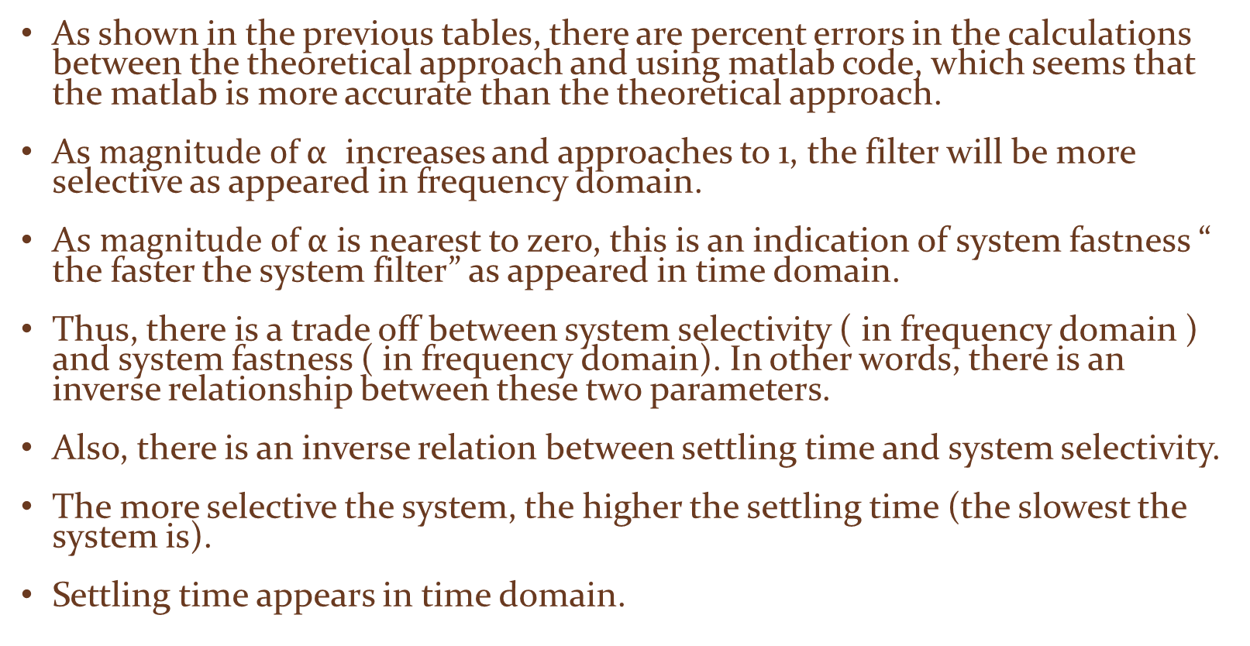
As shown in the previous tables, there are percent errors in the calculations between the theoretical approach and using matlab code, which seems that the matlab is more accurate than the theoretical approach.
As $magnitude \text{of} \text{α}$ increases and approaches to 1, the filter will be more selective as appeared in frequency domain.
A$s magnitude \text{of} \text{α}$is nearest to zero, this is an indication of system fastness “ the faster the system filter” as appeared in time domain.
Thus, there is a trade off between system selectivity ( in frequency domain ) and system fastness ( in frequency domain). In other words, there is an inverse relationship between these two parameters.
Also, there is an inverse relation between settling time and system selectivity.
The more selective the system, the higher the settling time (the slowest the system is).
Settling time appears in time domain.

